Slide 1
Master Thesis
cand. el. Dinggen Dai
02.11.2022
Notes:
good afternoon, everyone…

Slide 2
Structure
1 Motivation and Objective
2 Fundamental
3 Concept
4 Evaluation and Analyse
5 Conclusion and Outlook
Notes:
I will introduce the points step by step, from the original motivation to final conclusion.

Slide 3
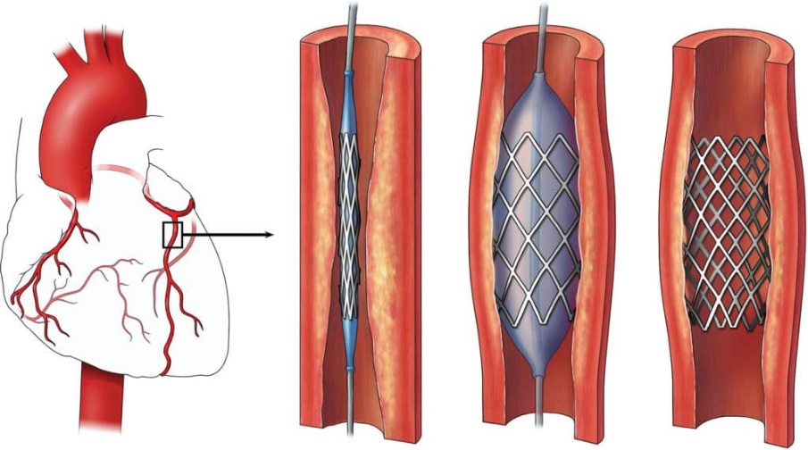
1.1 Motivation: background
Stent: a life-saving device
treat cardiovascular diseases [1-2]
Stent manufacture:
quality inspection: manual vs. automatic
high precision
faster
lower cost
Automatic inspect system is desirable! [3]
Stent implantation process [2]
Notes:
the first thing is the stent

Slide 4
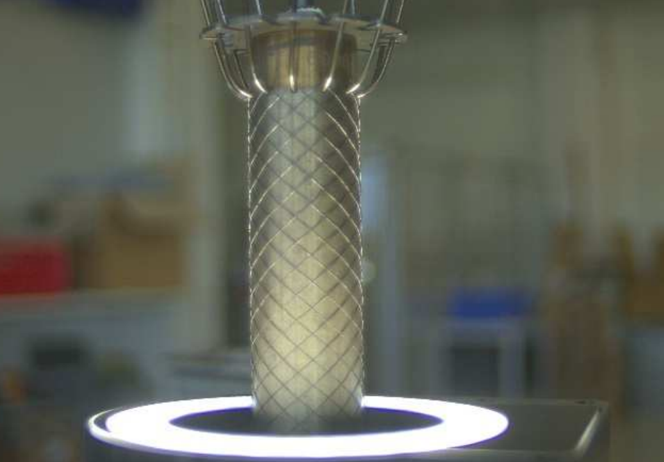
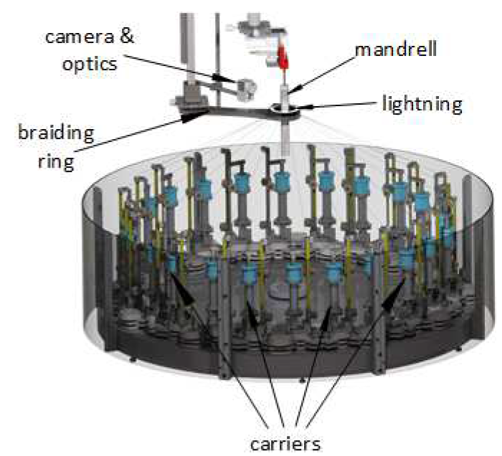
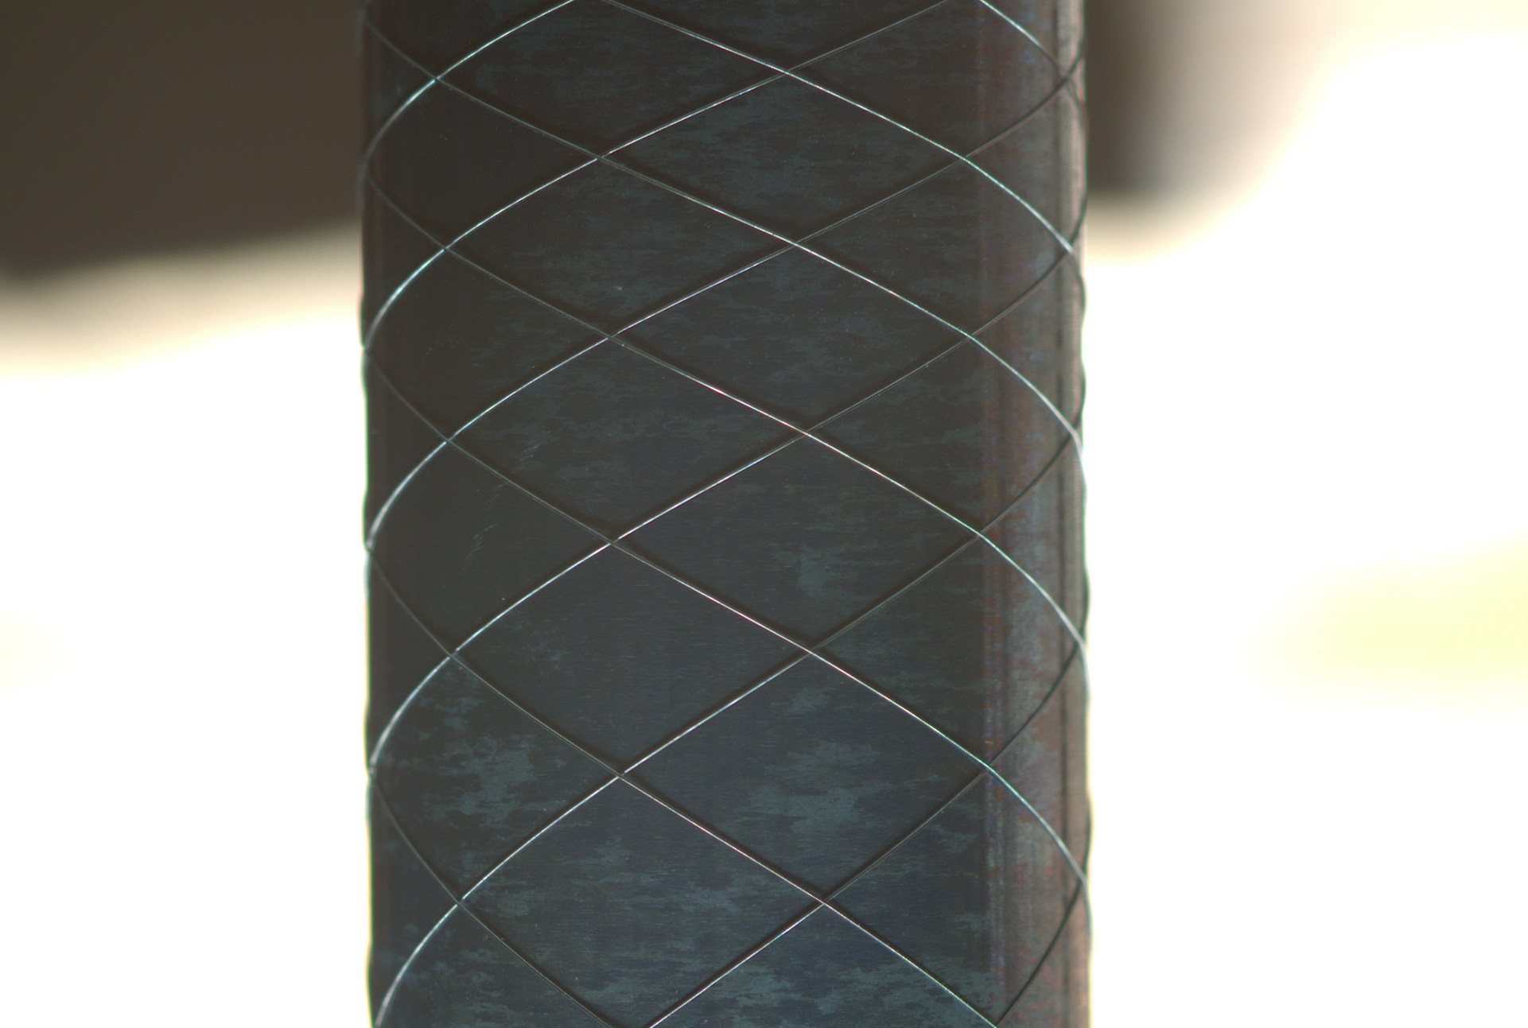
1.1 Motivation: background (Stent4Tomorrow) 这张应该去掉
visual inspection related parts [3]
pitch
manufacturing system [3]
focus on the stent
Notes:
That's why there is a project called Stent4Tomorrow, which aims to improve the manufacturing system of medical productions
the stent is the metal wire in a braiding form,
the mandrel is the black one supporting the stent
now, I label a pitch. when every pitch is in good geometric shape,

Slide 5
1.2 Objective: borders extraction
Issue 1: the size of the pitch
how to “enlarge”?
Issue 2: the background
single image size (3 - 8 MB)
how to remove?
less calculation
Solution: borders extraction!
Extra: build the mapping relation between image (pixel) and human perception (mm)
1. the diameter of the mandrel (in mm)
2. the distance of the borders (in pixel)
focus on the pitch
Notes:
But there are several issues:
When an image is resized, its pixel information is changed.

Slide 6
Structure
1 Motivation and Objective
2 Fundamental
3 Concept
4 Evaluation and Analyse
5 Conclusion and Outlook
Notes:
achieve my goal

Slide 7
2 Fundamental: research domain
Why choose LSD (Line Segment Detection)?
straightforward
Part I: classic image processing
4 approaches
Part II: deep learning based
2 approaches
borders extraction
Segmentation
……
LSD
……
Bounding box based object detection

Slide 8
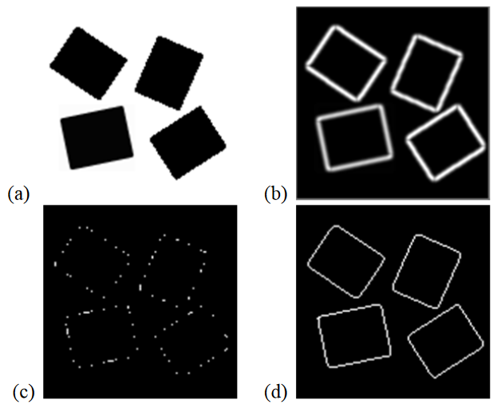
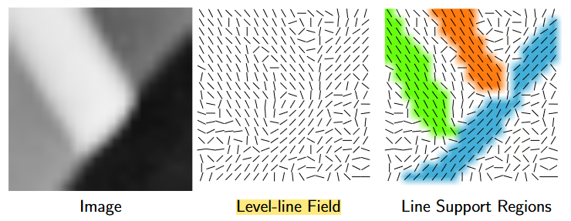
2.1.1 Classic: bottom-up
LSD: line segment detector (2010) [4]
today: still typical
EDLines (2011) [5]
10 times faster than LSD
(b) - (d): gradient map, anchor points, edge map
Gradient
LSD [4]
EDLines [5]

Slide 9
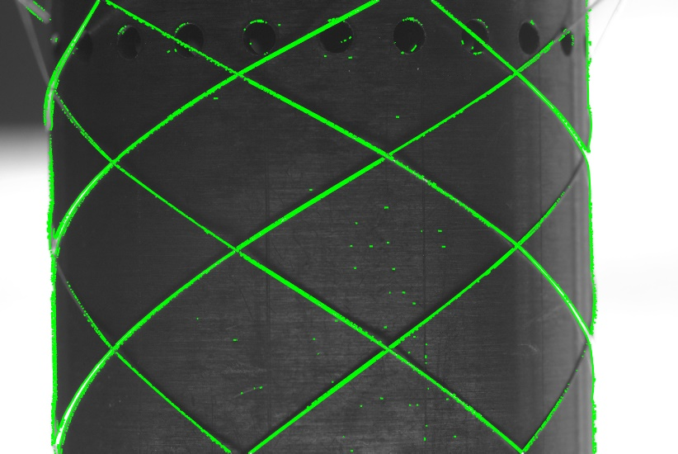
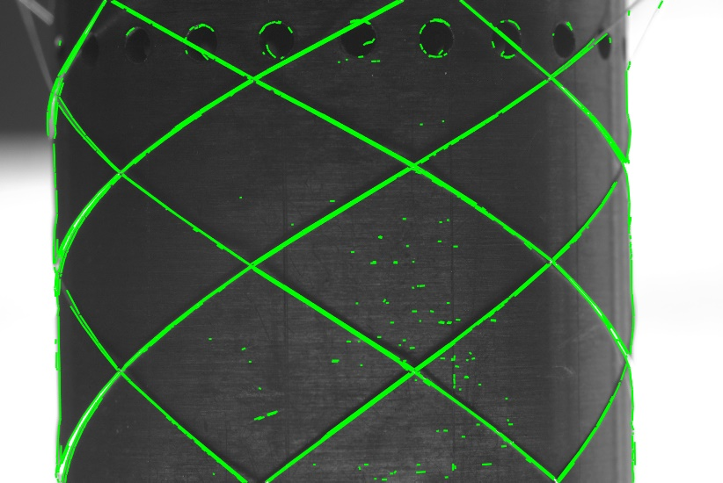
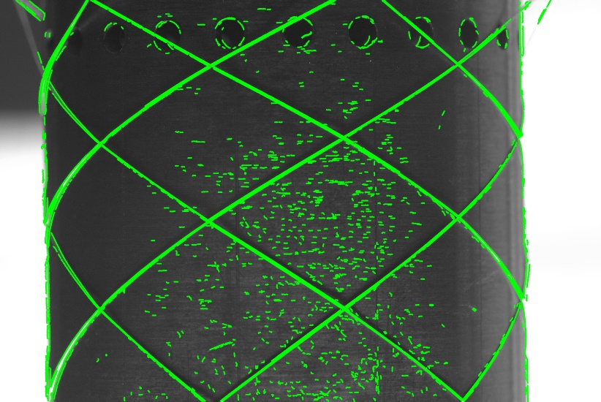
2.1.1 Classic: bottom-up
CannyPF (2015) [6]
based on canny filter: 2 parameters
parameter free: adjust the low and high thresholds self-adaptively
LSD
EDLines
CannyPF

Slide 10
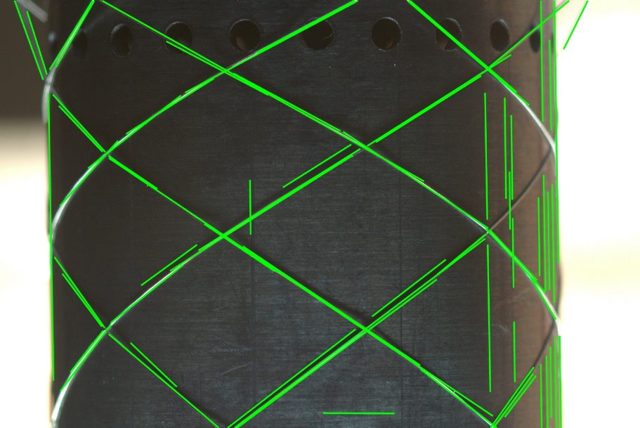
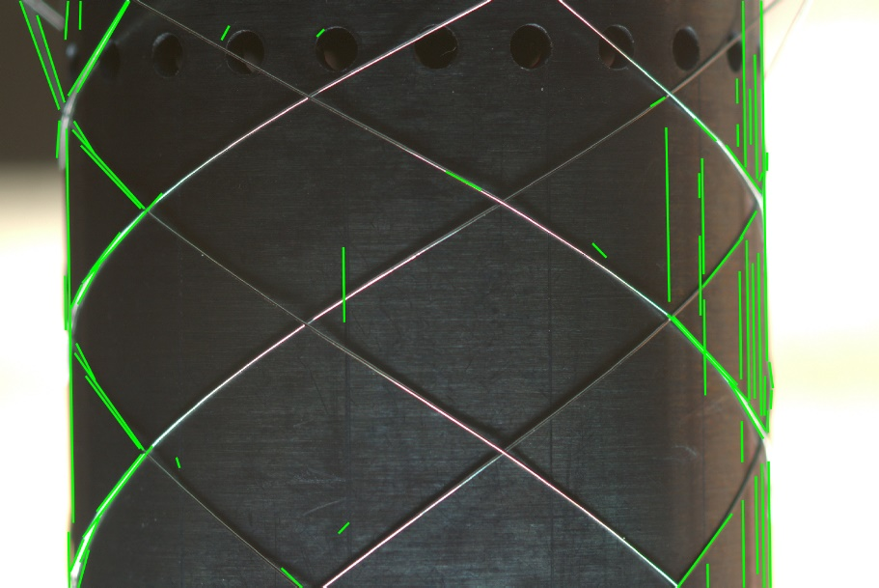

2.1.2 Classic: top-down
MCMLSD (CVPR 2017) [7]
Stage 1 PHT: global probabilistic Hough Transformation
Stage 2 MCM: Markov Chain Marginal
Markov chain model: over the sequence of points on the line
Label the line with probability
Notes:
The top 70 straight lines in terms of probability

Slide 11
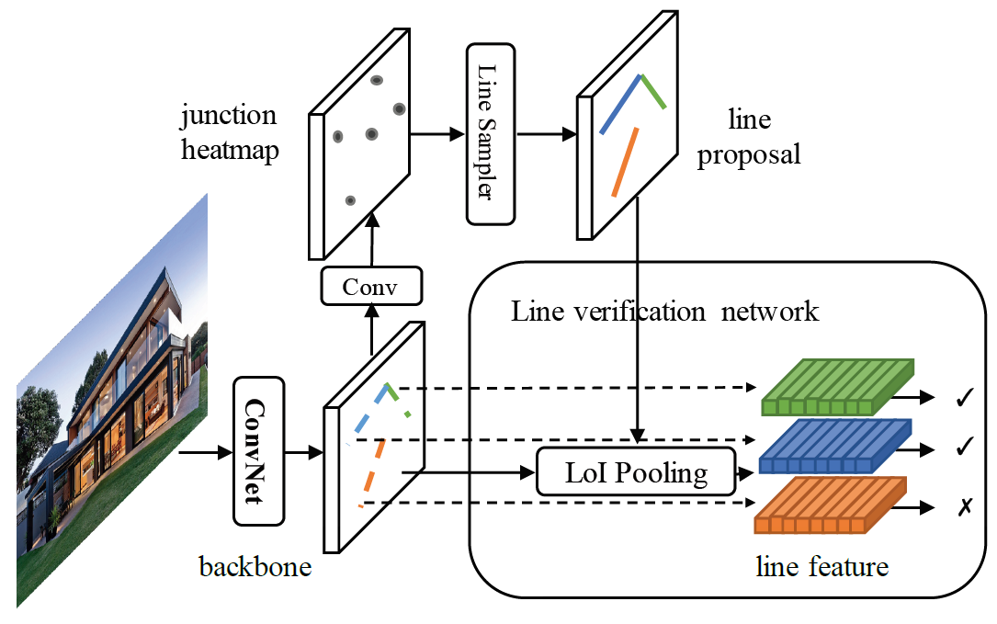
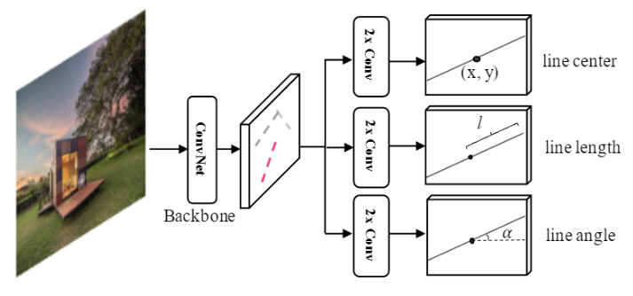
2.2 Deep learning
HT-LCNN (ECCV 2020) [8]
based on LCNN (ICCV 2019) [9]
add a Hough Transfrom block
Output: lines each by 2 junctions
F-Clip [10]
SOTA of the line detectors (2021)
only one stage: ~18 times faster
Output: lines each by 3 elements
An overview of LCNN architecture
An overview of F-Clip architecture
Notes:
F-Clip: Fully Convolutional line parsing

Slide 12
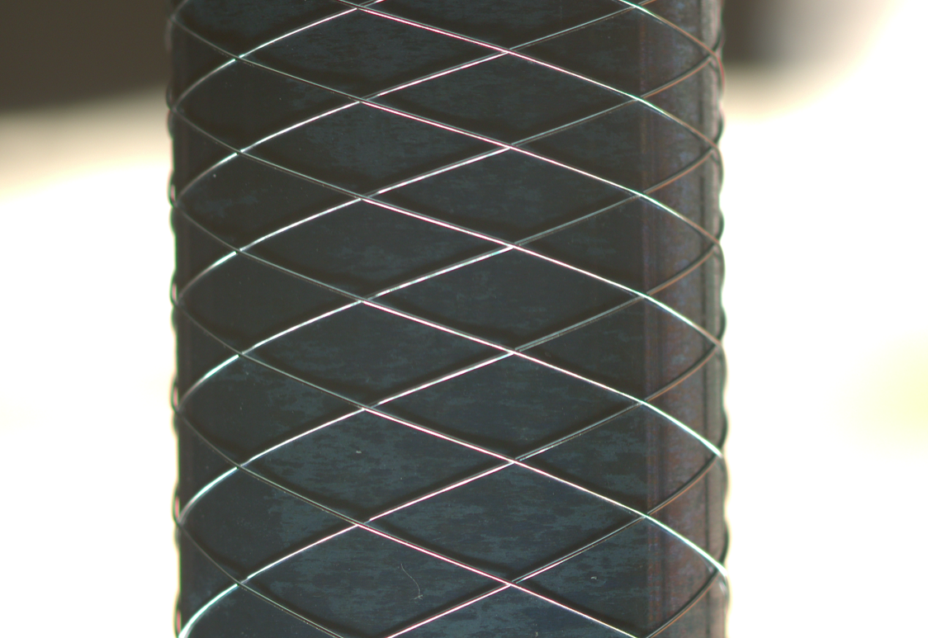
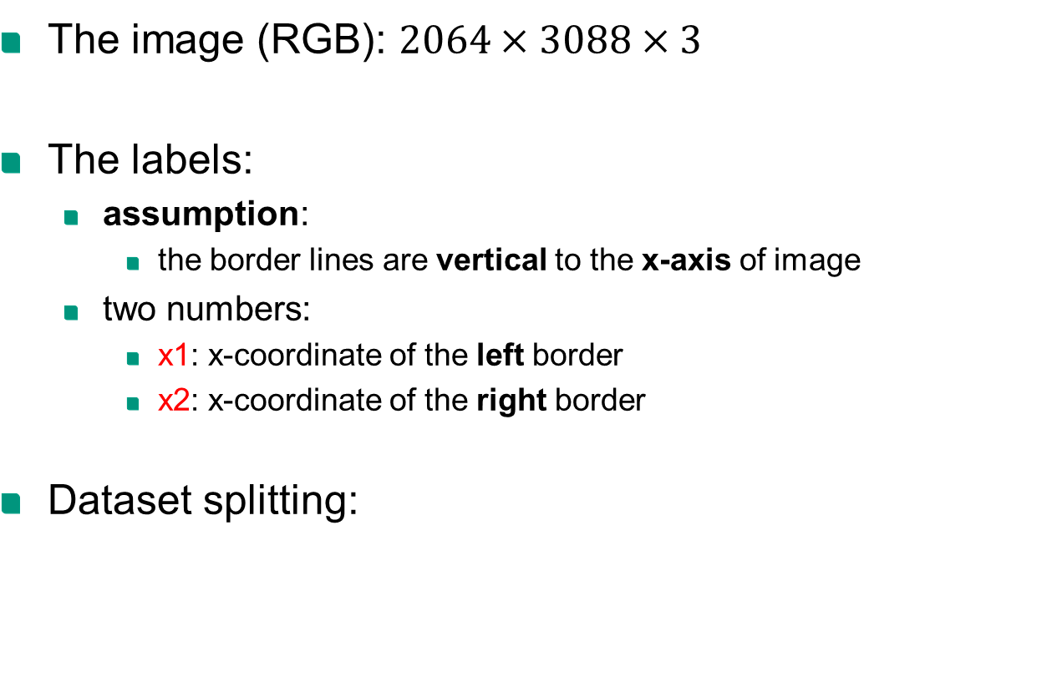
2.3 Input: Dataset
x1
x
x2
The image (RGB): $2064×3088×3$
The labels:
assumption:
the border lines are vertical to the x-axis of image
two numbers:
x1: x-coordinate of the left border
x2: x-coordinate of the right border
Dataset splitting:
y
 | Training | Validation | Test
Images | 4881 | 1085 | 1508

Slide 13

2.4 Output: two border lines
Evalutation metrics:
1. RSE (root square error): $\sqrt{{d1}^{2}+{d2}^{2}}$
2. execution time
x1
x
x2
y
d1
d2

Slide 14
Summary of fundamental
LSD: typical (2010)
Bottom-up
EDLines: faster (2011)
Classic image processing
CannyPF (2015)
Top-down
MCMLSD (CVPR 2017)
LSD
HT-LCNN (ECCV 2020)
Deep learning
F-Clip (SOTA in 2021)

Slide 15
Structure
1 Motivation and Objective
2 Fundamental
3 Concept
4 Evaluation and Analyse
5 Conclusion and Outlook

Slide 16
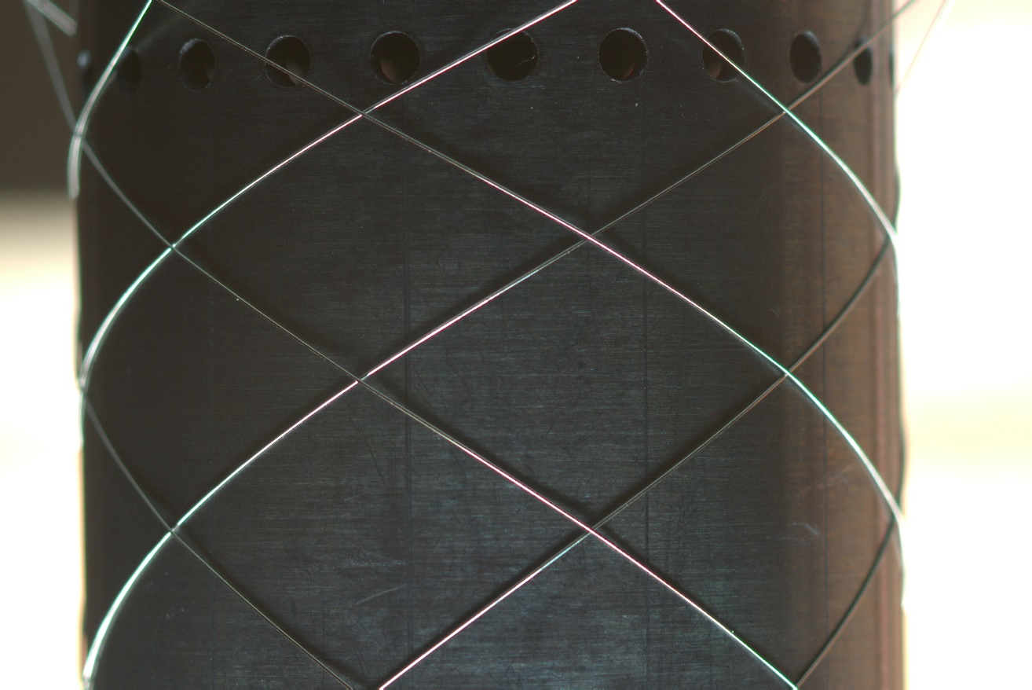
3.1 Concept: classic approaches
Start
Load RGB image
Edge detector
Valid edge extractor
Border line generator
Get border lines
End

Slide 17

3.1 Concept: classic approaches
Start
Load RGB image
Edge detector
Valid edge extractor
Border line generator
Get border lines
LSD (2010)
End

Slide 18
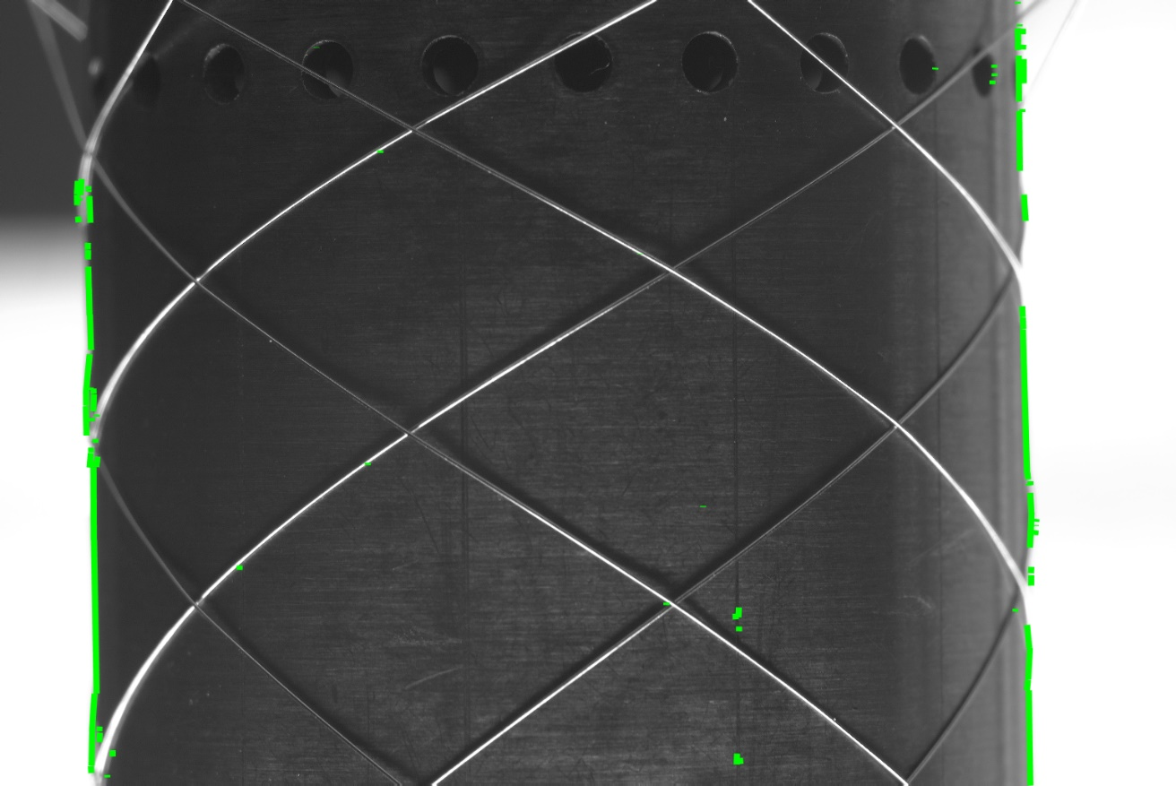
3.1 Concept: classic approaches
Start
Load RGB image
Edge detector
Valid edge extractor
Border line generator
Get border lines
angle filter + moving window
End

Slide 19
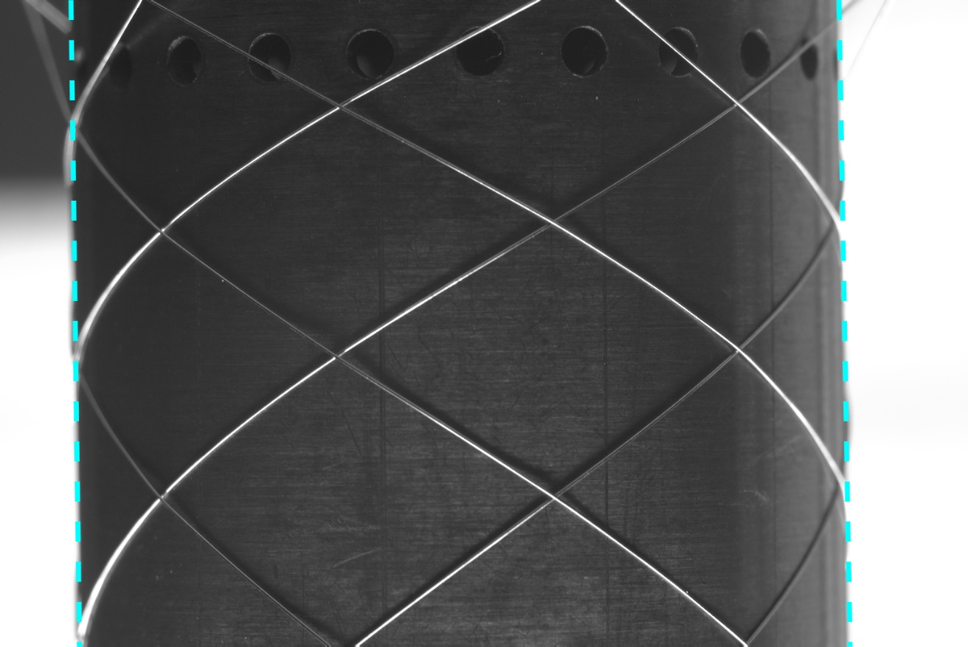
3.1 Concept: classic approaches
Start
Load RGB image
Edge detector
Valid edge extractor
Border line generator
Get border lines
least square method
End

Slide 20
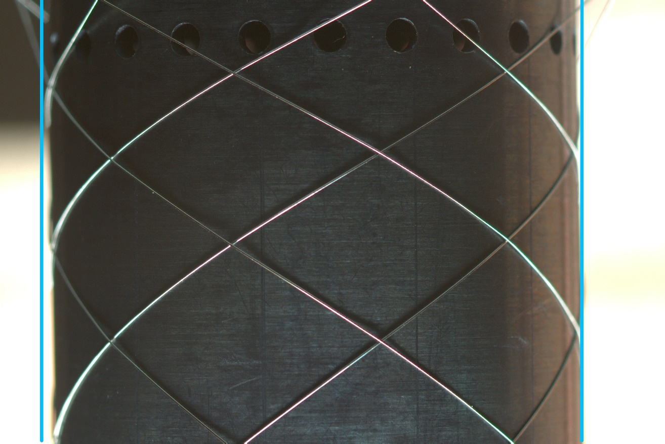
3.2 Concept: deep learning approaches
Start
Load RGB image
Backbone
Model:
Head: multitask learner
Head: line prediction
Get border lines
End

Slide 21
Structure
1 Motivation and Objective
2 Fundamental
3 Concept
4 Evaluation and Analyse
5 Conclusion and Outlook

Slide 22
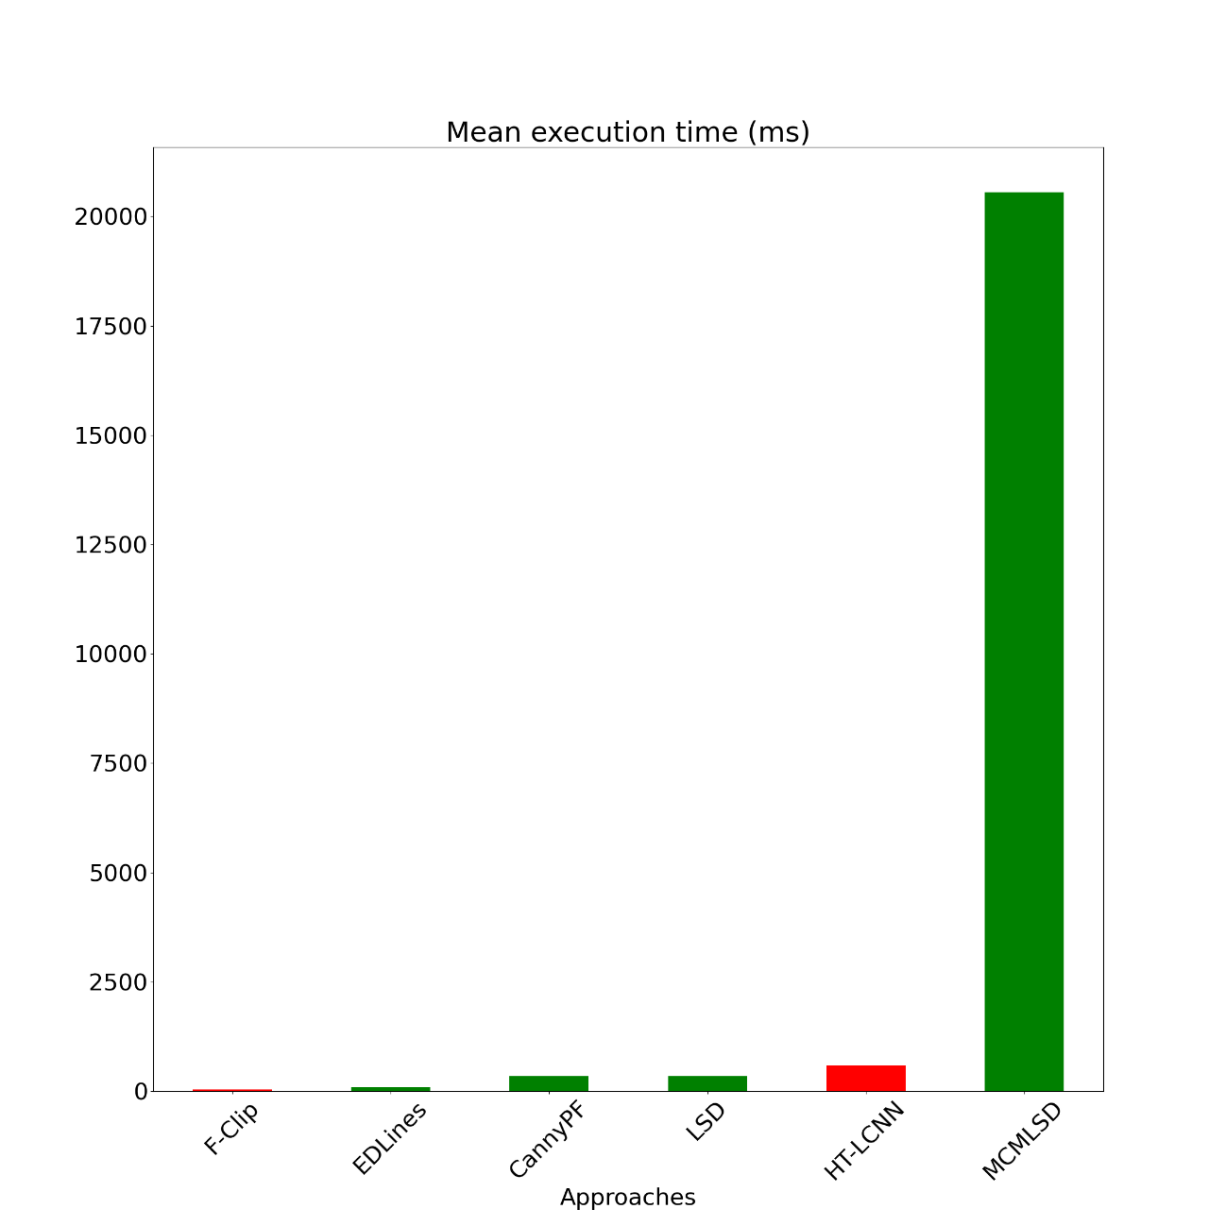
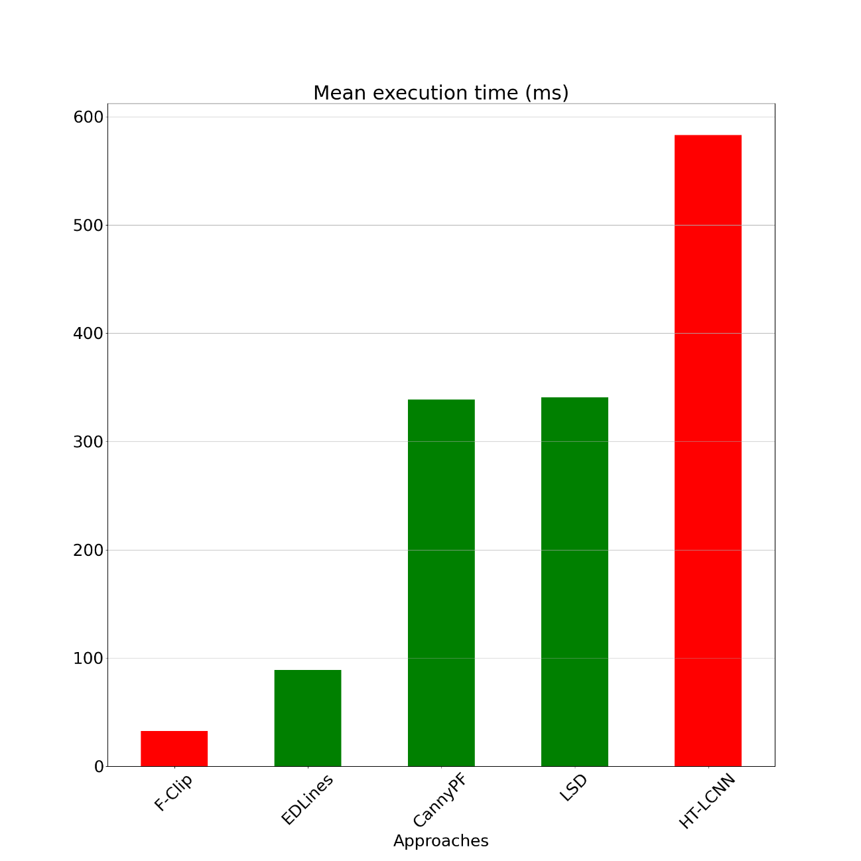
4.1 Metric: mean execution time

Slide 23
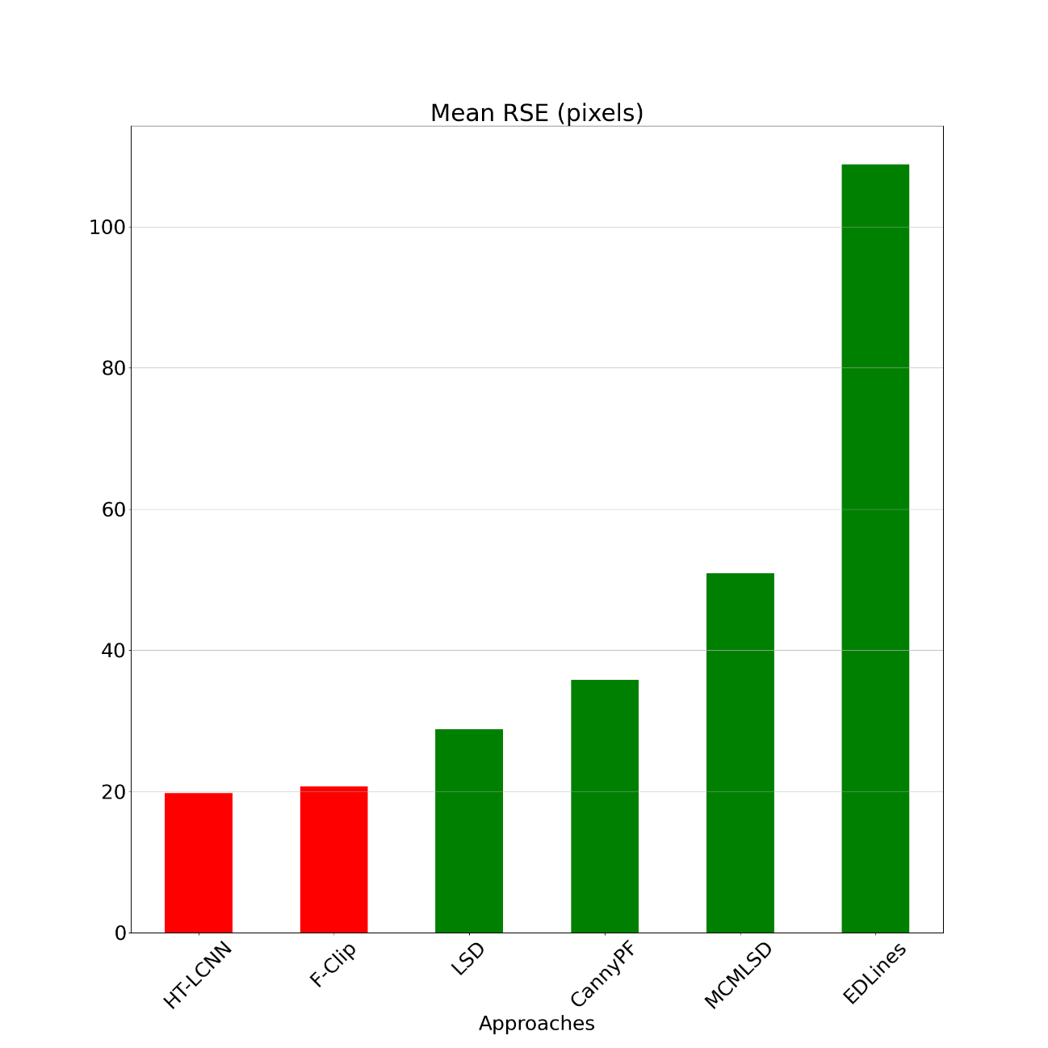
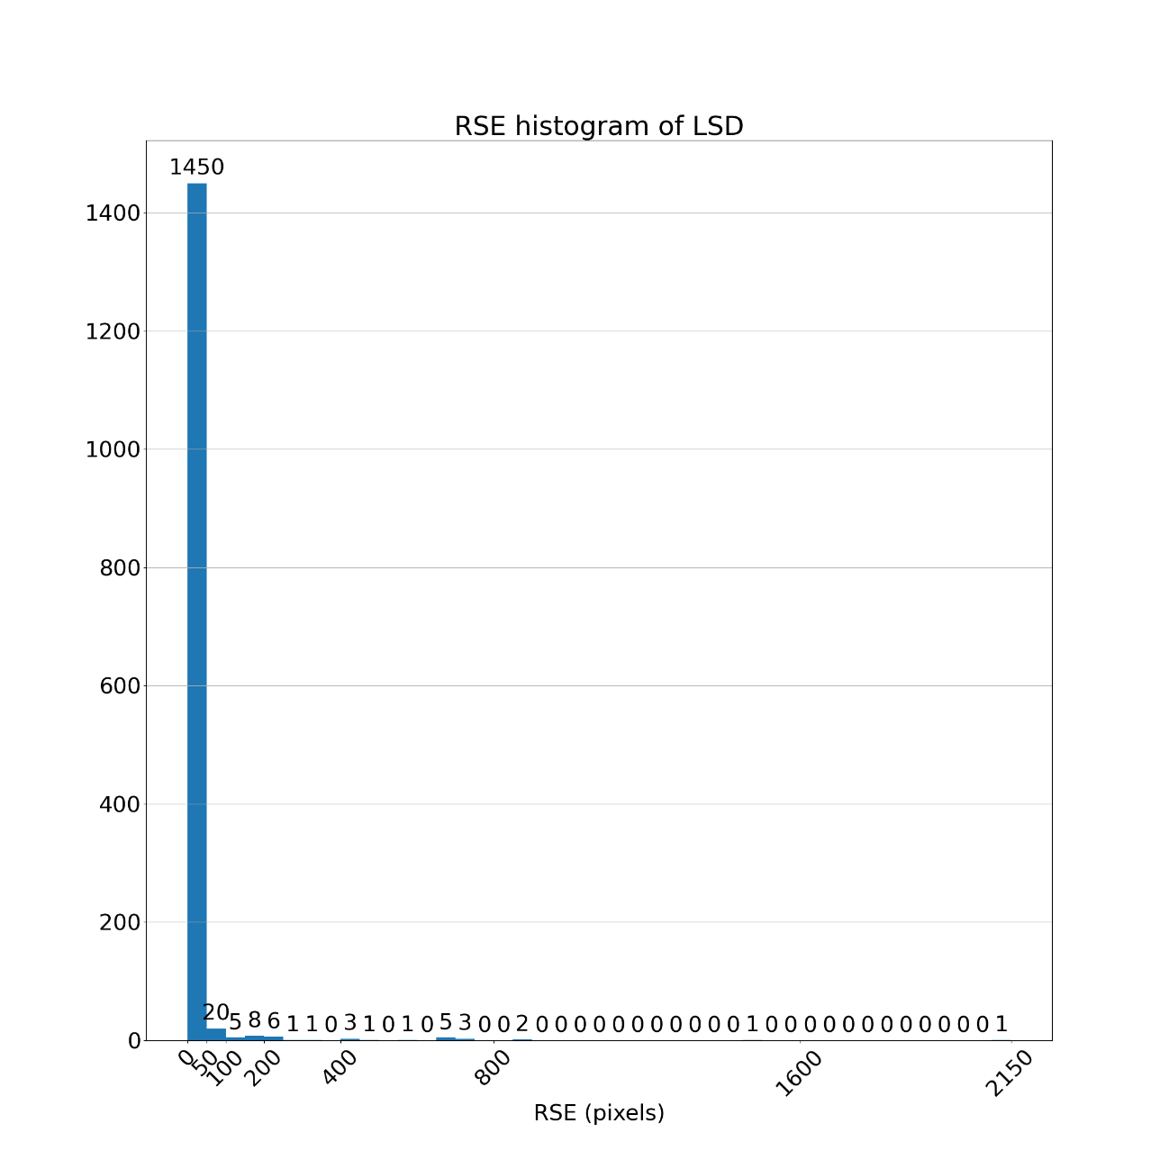
4.2 Metric: mean RSE (root square error)

Slide 24
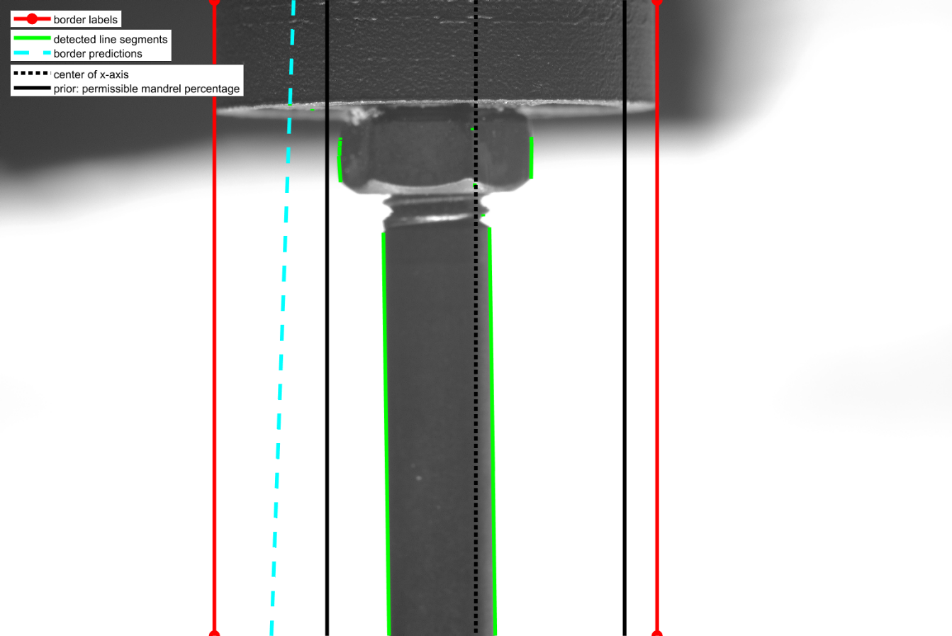
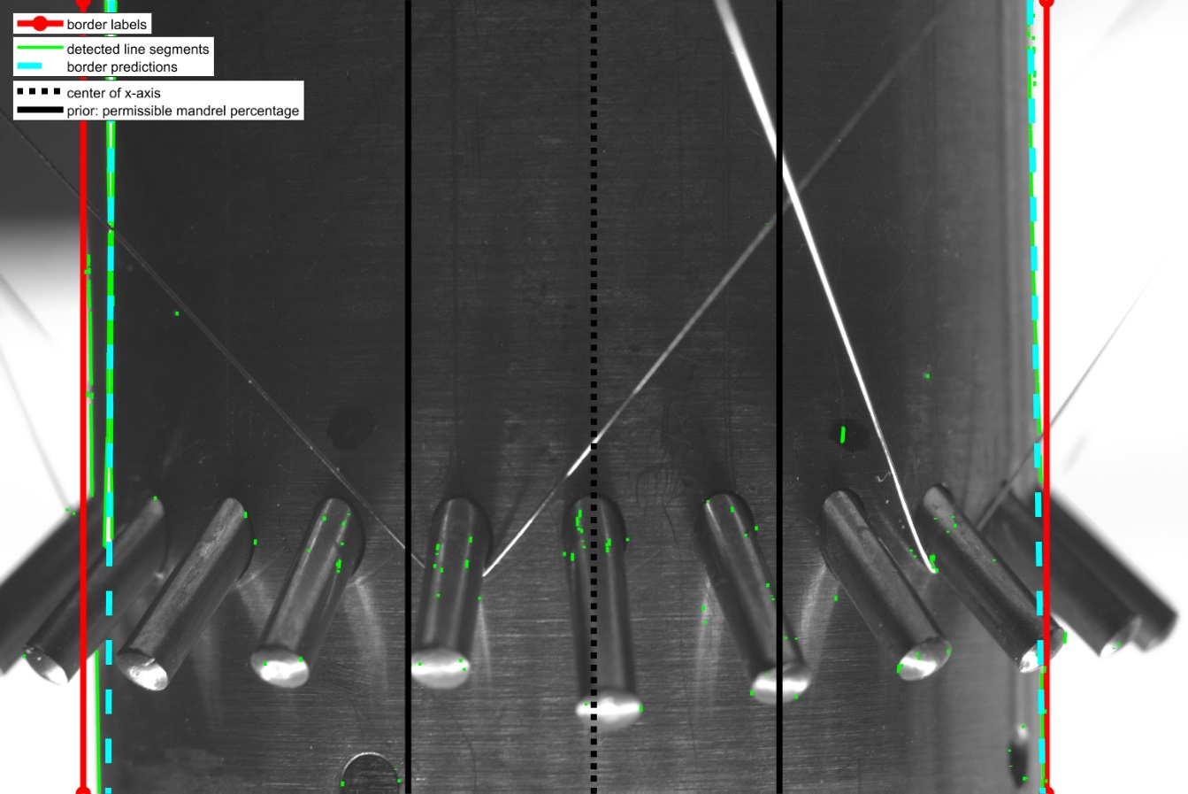
4.2 Metric: mean RSE (classic)
LSD: 2 kinds of bad cases
General in all classic approaches
Case 1: no edge detected around the borders
Case 2: noise (stent wire)

Slide 25
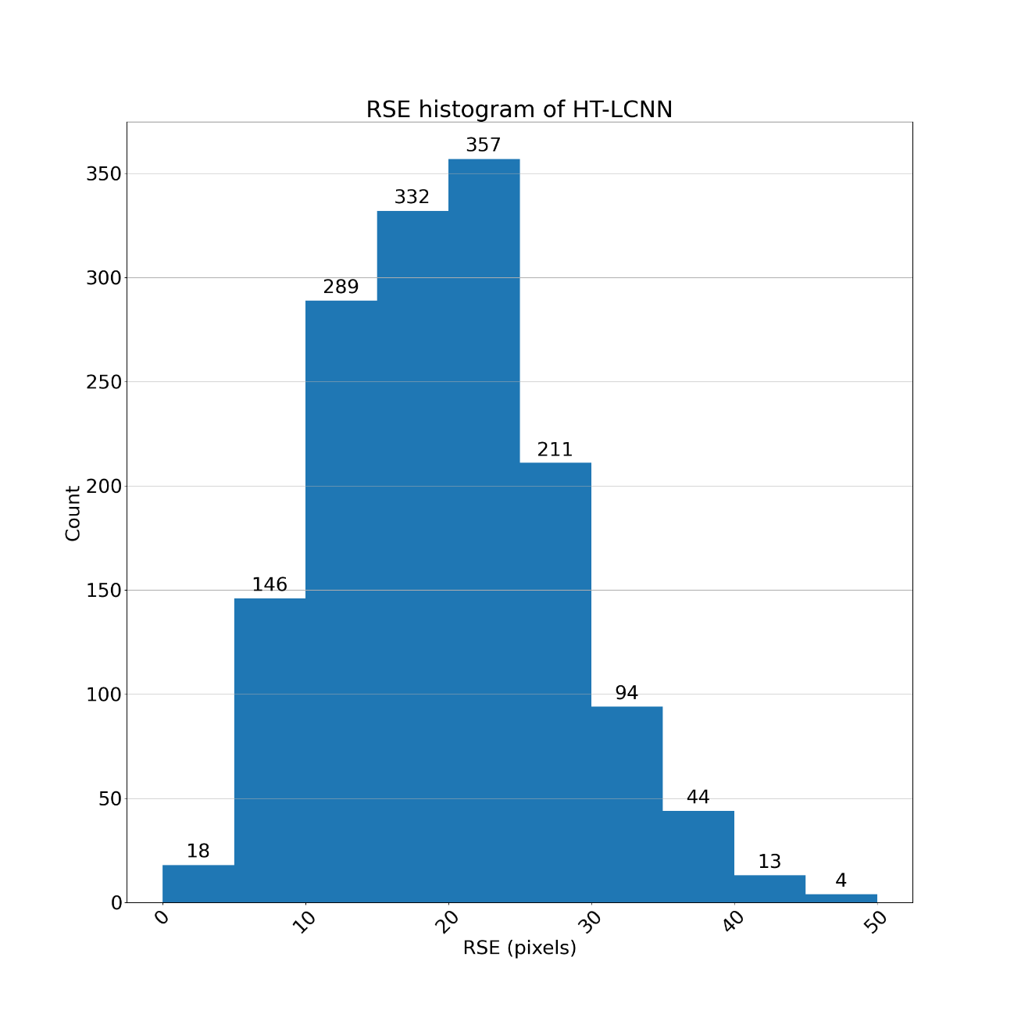
4.2 Metric: mean RSE (deep learning)

Slide 26
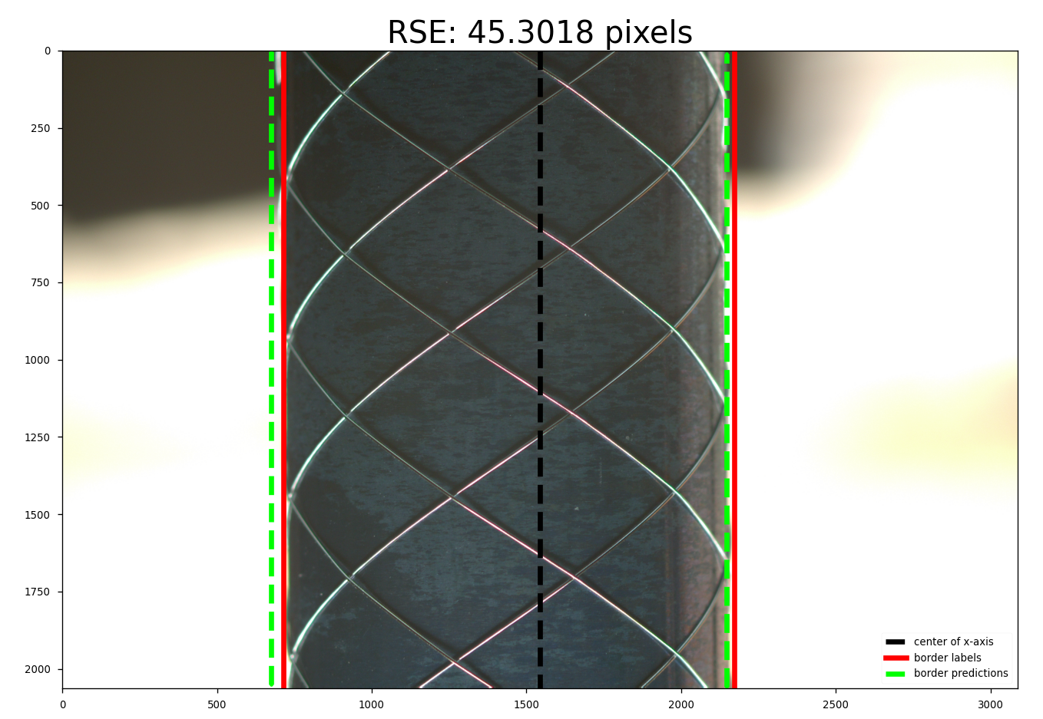
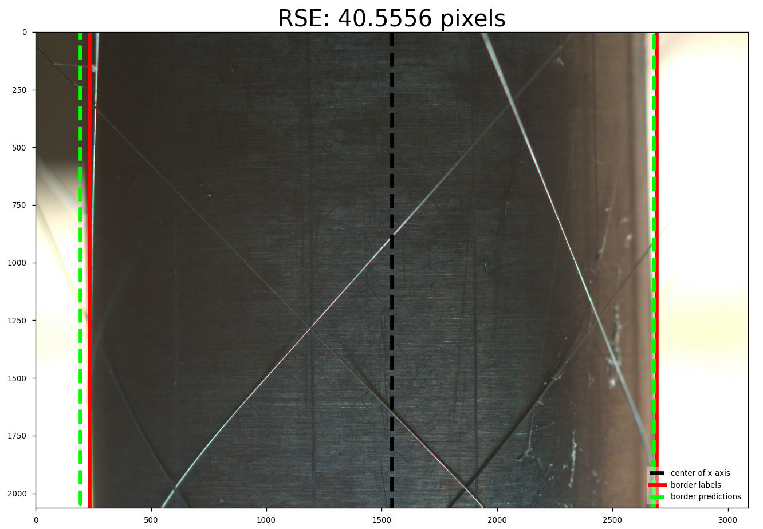
4.2 Metric: mean RSE (deep learning)
HT-LCNN: the predicted left border line in the left side of the labeled

Slide 27
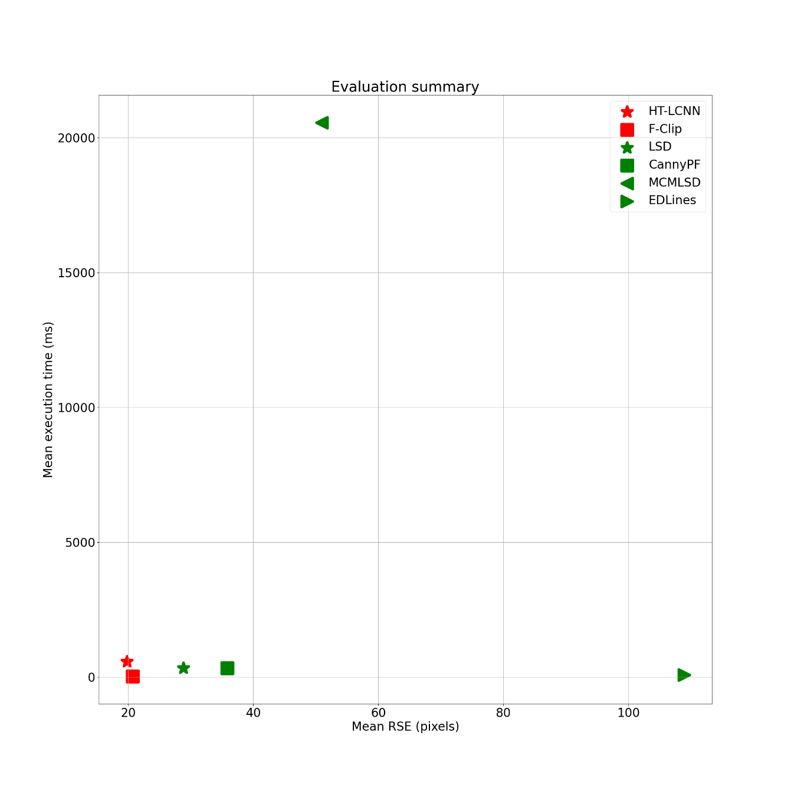
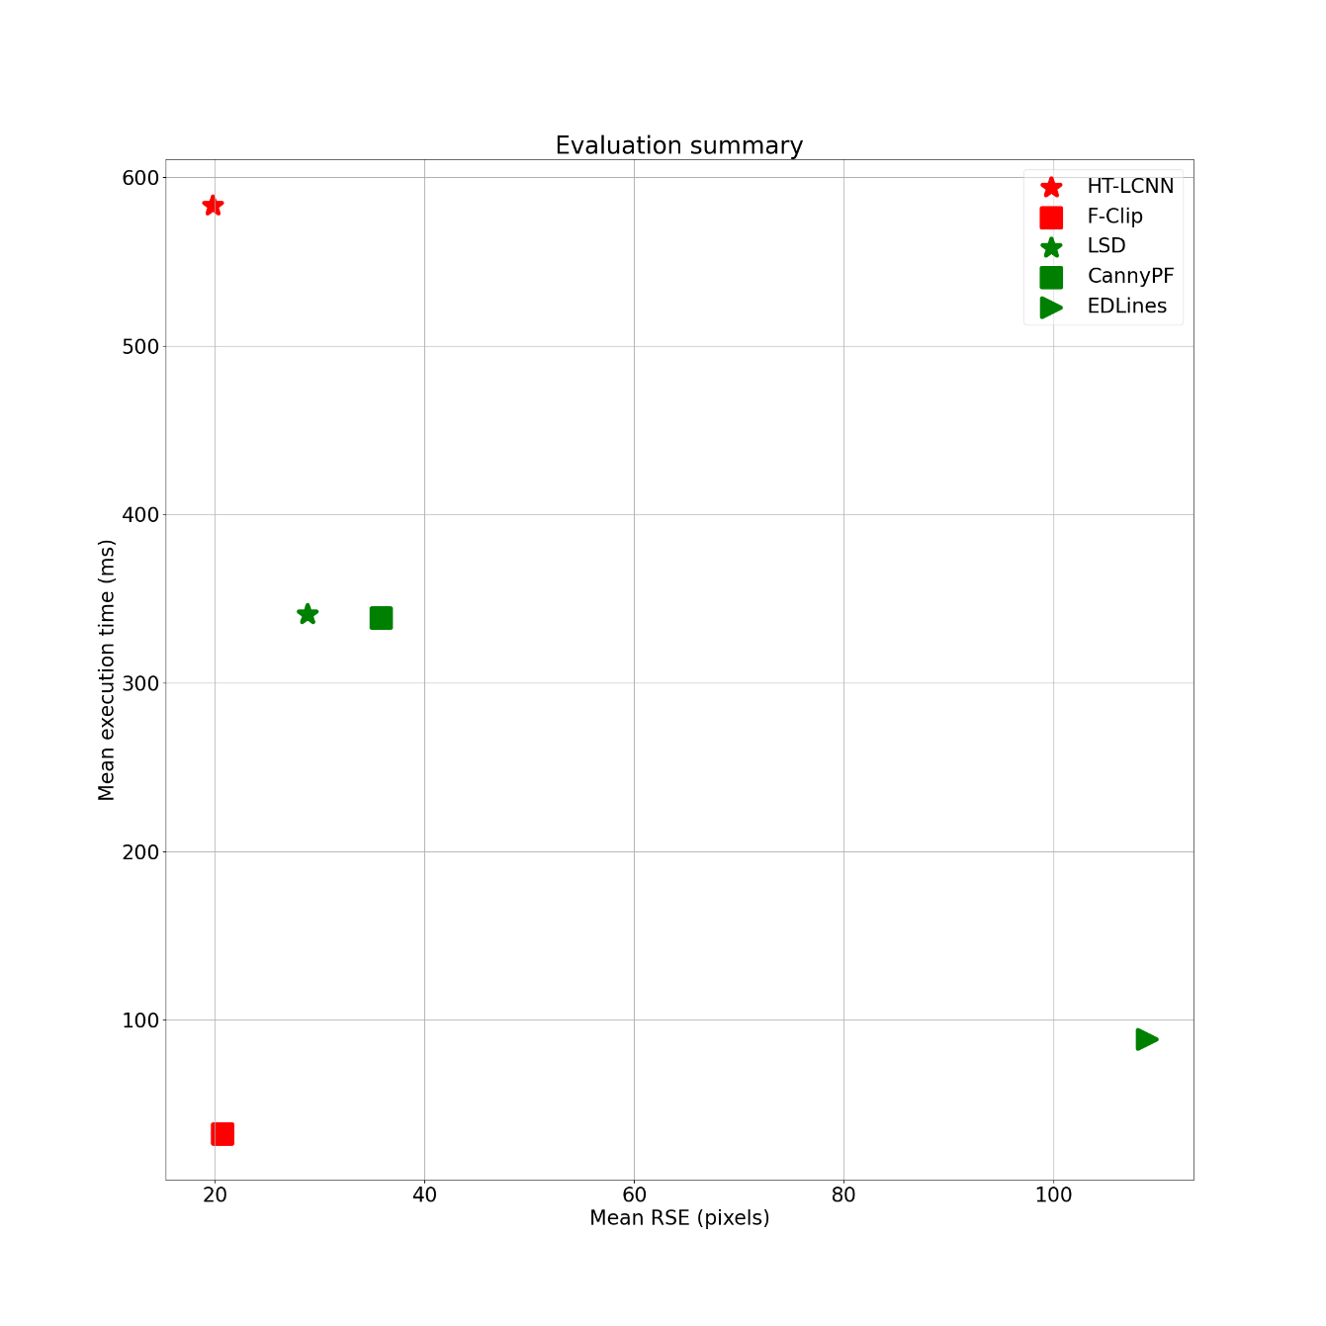
4.3 Metrics: summary
F-Clip

Slide 28
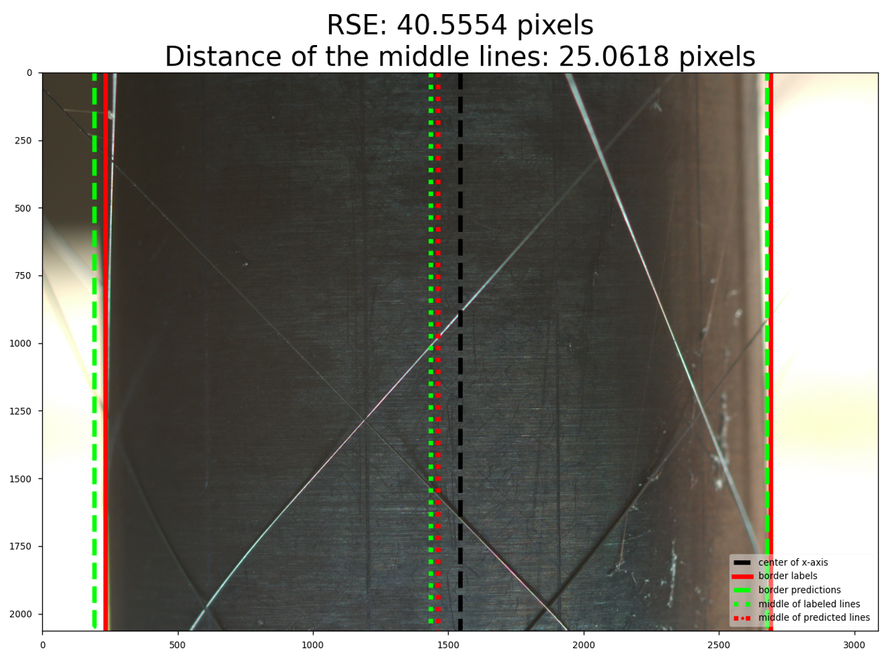
4.4 Extra: position error of the mandrel from pixel to mm
Position of the mandrel
middle of labeled lines
Prior knowledge: 70 pixels / mm
the diameter of the stent wire: 0.1 mm
AE: distance of the middle lines
MAE: 12.57 pixels (F-Clip)
0.18 mm

Slide 29
Structure
1 Motivation and Objective
2 Fundamental
3 Concept
4 Evaluation and Analyse
5 Conclusion and Outlook

Slide 30

5 Conclusion and outlook
Conclusion:
Implemented / reproduced 6 approaches
RSE:
DL models show better performance: more robust to the noise
Lowest in all approaches: HT-LCNN 19.77 pixels
Lowest in classical approaches: LSD 28.8 pixels
Execution time in addition: F-Clip is the fastest (32 ms), 20.72 pixels
Outlook:
Classical approaches: use LSD, deal with the two bad cases
Deep learning: use two junctions to represent a border line
more accurate
the border lines are actually skewed (not vertical)
easier to perceive and label (in the middle part)

Slide 31
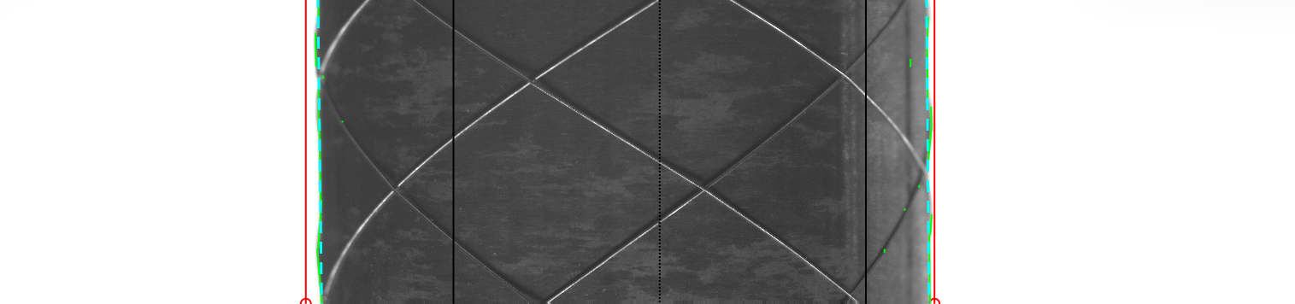
Thank you for your attention!

Slide 32
Appendix - Reference
[1] “Todesursachen,” Statistisches Bundesamt. https://www.destatis.de/DE/Themen/Gesellschaft-Umwelt/Gesundheit/Todesursachen/_inhalt.html (accessed Nov. 01, 2022).
[2] “Stents - What to Expect When Getting a Stent | NHLBI, NIH.” https://www.nhlbi.nih.gov/health/stents/during (accessed Nov. 01, 2022).
[3] B. Haas, M. Braeuner, K. Lehmann, and E. Sax, “Evaluation of different methods to measure a stent’s pitch length in an industrial environment,” in 2021 International Conference on Electrical, Computer, Communications and Mechatronics Engineering (ICECCME), Oct. 2021, pp. 1–6. doi: 10.1109/ICECCME52200.2021.9590830.

Slide 33
Appendix - Reference
[4] R. Grompone von Gioi, J. Jakubowicz, J.-M. Morel, and G. Randall, “LSD: A Fast Line Segment Detector with a False Detection Control,” IEEE Transactions on Pattern Analysis and Machine Intelligence, vol. 32, no. 4, pp. 722–732, Apr. 2010, doi: 10.1109/TPAMI.2008.300.
[5] C. Akinlar and C. Topal, “Edlines: Real-time line segment detection by Edge Drawing (ed),” in 2011 18th IEEE International Conference on Image Processing, Sep. 2011, pp. 2837–2840. doi: 10.1109/ICIP.2011.6116138.
[6] X. Lu, J. Yao, K. Li, and L. Li, “CannyLines: A parameter-free line segment detector,” in 2015 IEEE International Conference on Image Processing (ICIP), Sep. 2015, pp. 507–511. doi: 10.1109/ICIP.2015.7350850.

Slide 34
Appendix - Reference
[7] E. J. Almazàn, R. Tal, Y. Qian, and J. H. Elder, “MCMLSD: A Dynamic Programming Approach to Line Segment Detection,” in 2017 IEEE Conference on Computer Vision and Pattern Recognition (CVPR), Jul. 2017, pp. 5854–5862. doi: 10.1109/CVPR.2017.620.
[8] Y. Zhou, H. Qi, and Y. Ma, “End-to-End Wireframe Parsing,” in 2019 IEEE/CVF International Conference on Computer Vision (ICCV), Oct. 2019, pp. 962–971. doi: 10.1109/ICCV.2019.00105.
[9] Y. Lin, S. L. Pintea, and J. C. van Gemert, “Deep Hough-Transform Line Priors,” in Computer Vision – ECCV 2020, Cham, 2020, pp. 323–340. doi: 10.1007/978-3-030-58542-6_20.

Slide 35
Appendix - Reference
[10] X. Dai, H. Gong, S. Wu, X. Yuan, and M. Yi, “Fully convolutional line parsing,” Neurocomputing, vol. 506, pp. 1–11, Sep. 2022, doi: 10.1016/j.neucom.2022.07.026.
[11] “Hidden Markov Model.” http://personal.psu.edu/jol2/hmm.html (accessed Nov. 01, 2022).

Slide 36
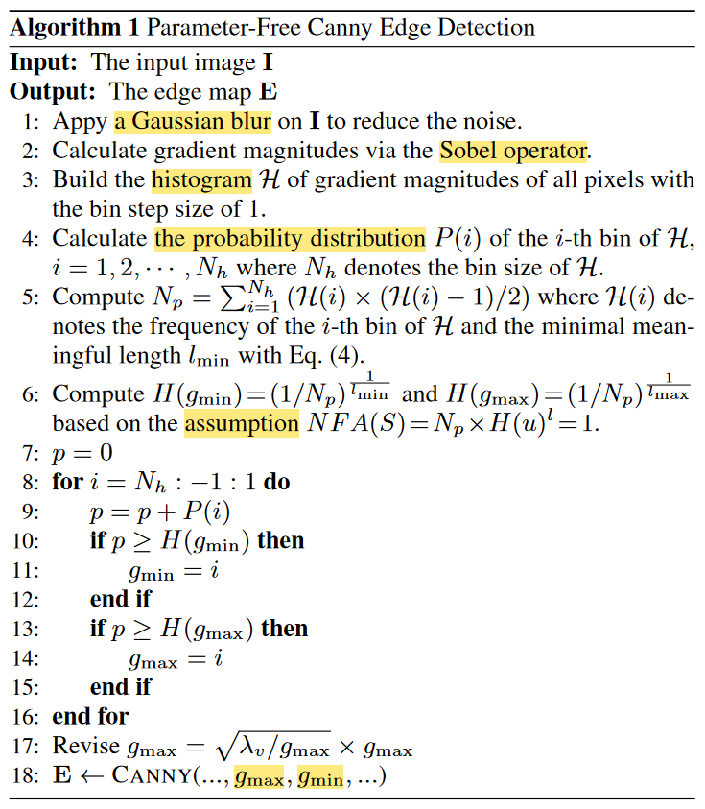
CannyPF
The algorithm of CannyPF [6]

Slide 37
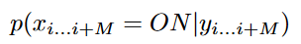
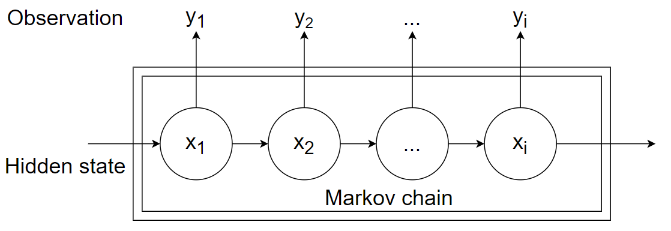

MCMLSD [7]
HMM: hidden markov model
$y_{i}$: the observation of the detected line at pixel i
$x_{i}$: binary hidden segment state (ON or OFF) indicating whether a visible segment is present at pixel i on the line
One of the ranking methods:
posterior probability of line segment
HMM [11]

Slide 38
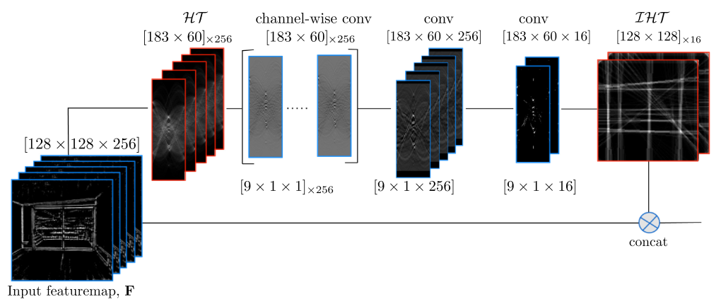
HT-LCNN
HT-IHT block [9]

Slide 39
Hardware and Software
Hardware
CPU: Intel Core(TM) i5-9600K 3.70 GHz
6 Core
GPU: GeForce RTX 2080 super 8 GB
RAM: 16 GB
Software
Operating system: Windows 10 (64-bit)
Matlab 2020a
Visual Studio 2019 (C++ code)
OpenCV 4.6.0 (for C++)
Visual Studio Code 2017 (Python code)
conda terminal (Anaconda 2)
Python 3.9.12
OpenCV 4.6.0 (for Python)
PyTorch 1.12.1 + CUDA 11.6

